Slide 1

Azure Data Factory Case Study Group-6
Praket Sanganeria
Sanjana Godiawala
Shyam Tibrewal
Siddharth Singh
Srishty Bedi

Slide 2
STEP 1:
Preparing dataset
STEP 2:
Creating container after storage account
STEP 3:
Uploading files in the container
STEP 4:
Creating ADF
STEP 4.1:
Creating Linked service
STEP 5:
Creating three datasets in ADF
(2 XML, 1 TARGET)
STEP 6:
Creating dataflow
src1+ src2 + flatten1 + flatten2 + union + sink
STEP 7:
Creating a pipeline, adding and selecting df
STEP 8:
Validating and publishing
STEP 9:
Add Trigger and monitoring the pipeline
STEP 10:
Going and checking the result in storage account

Slide 3
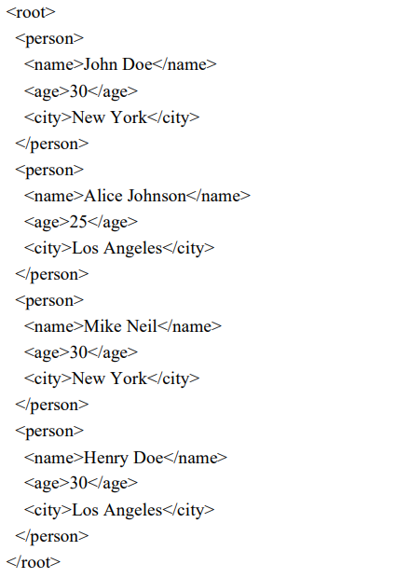
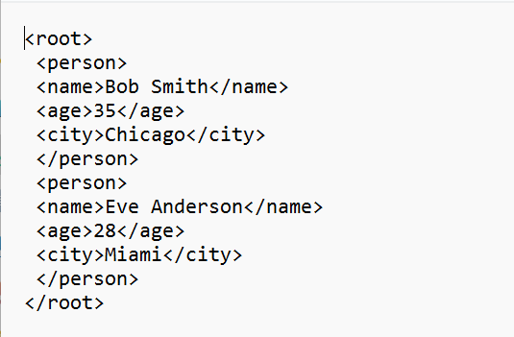

Slide 4
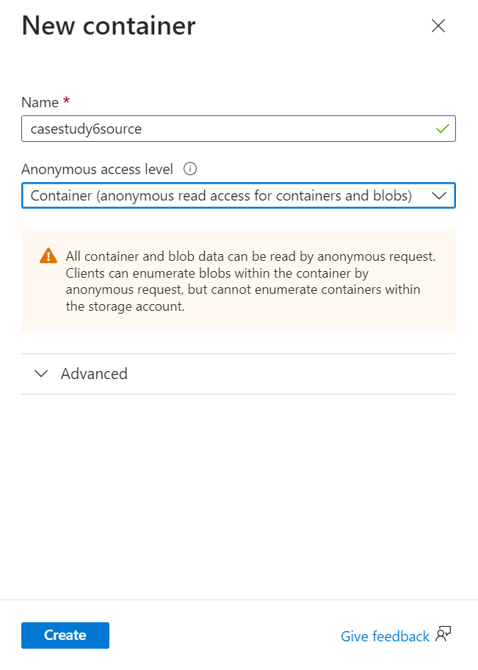
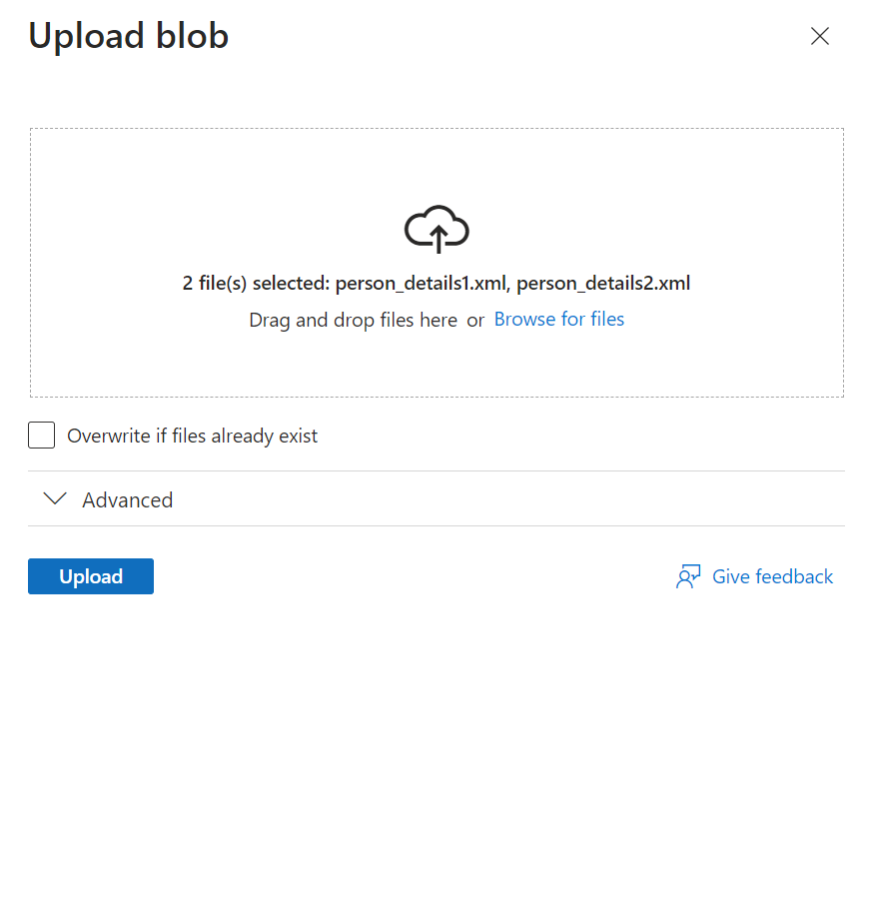

Slide 5
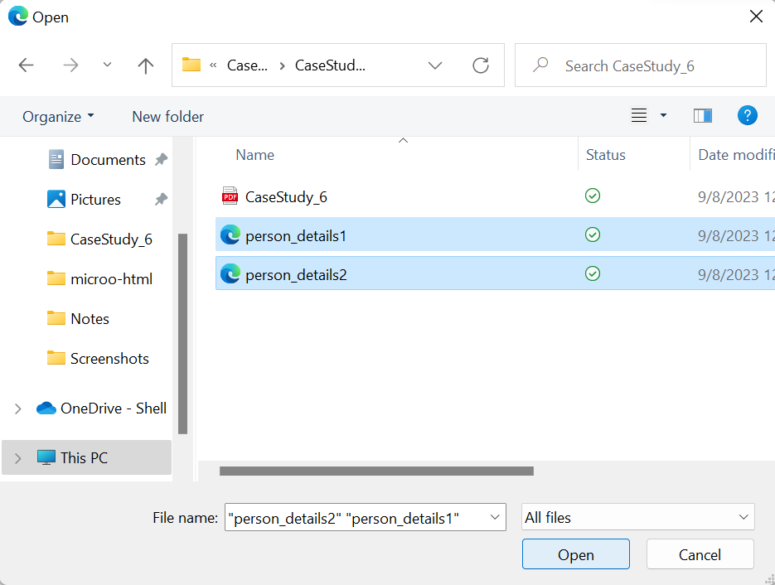

Slide 6
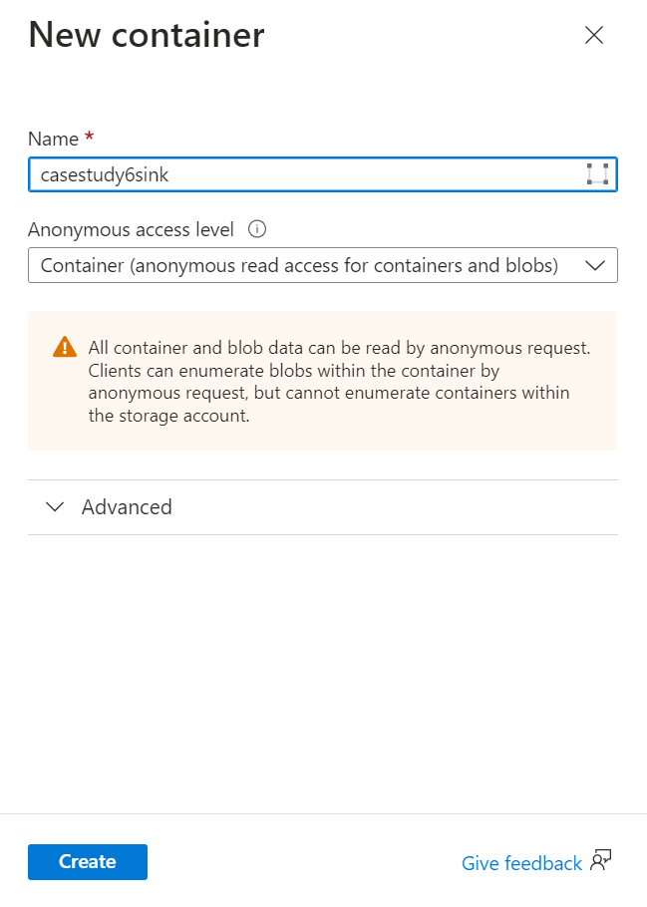

Slide 7
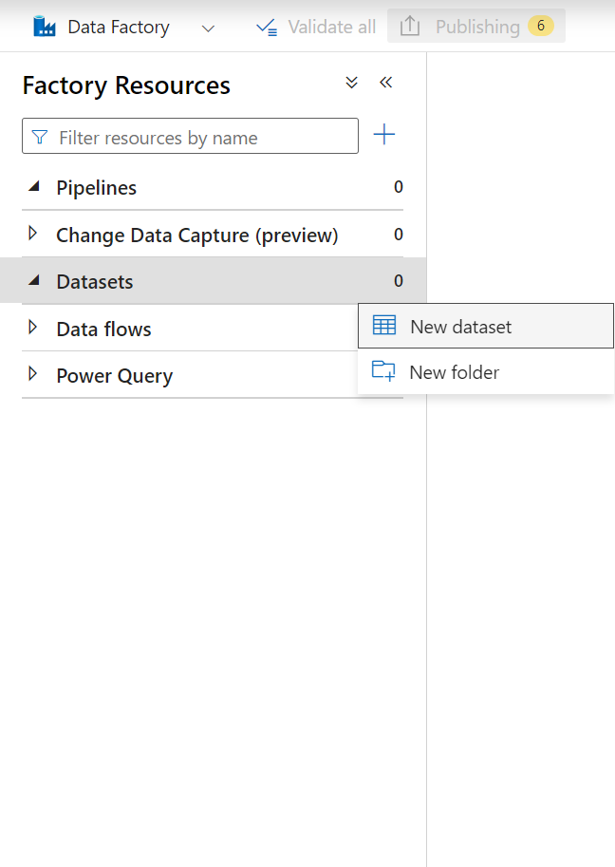
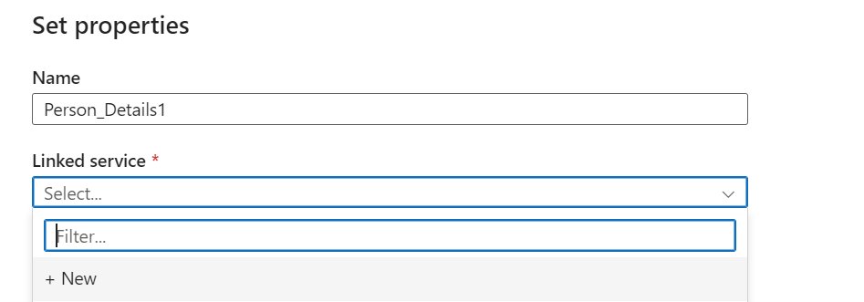

Slide 8
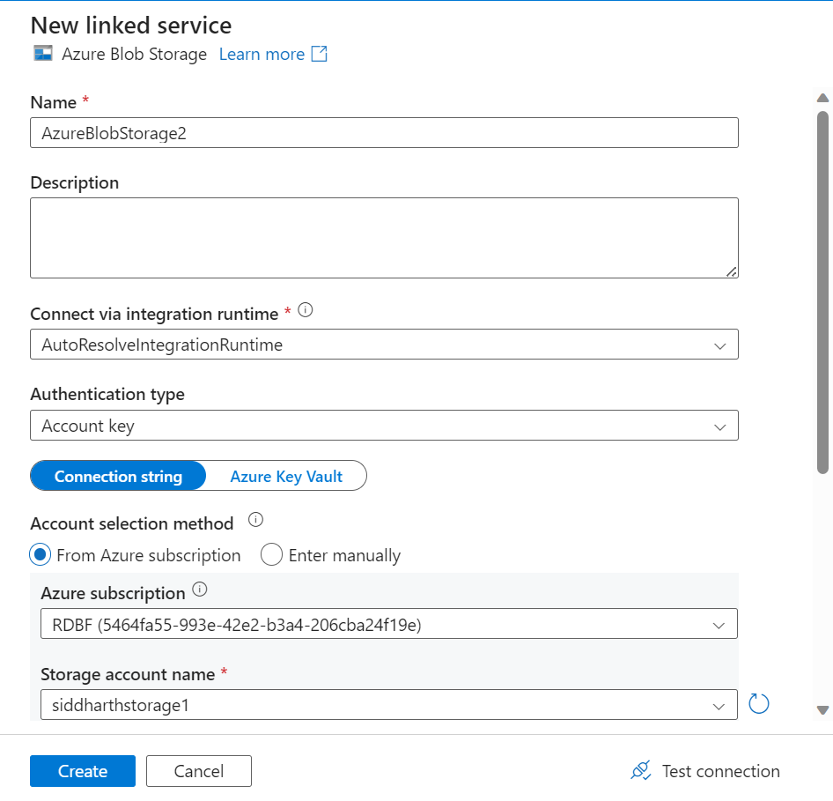

Slide 9
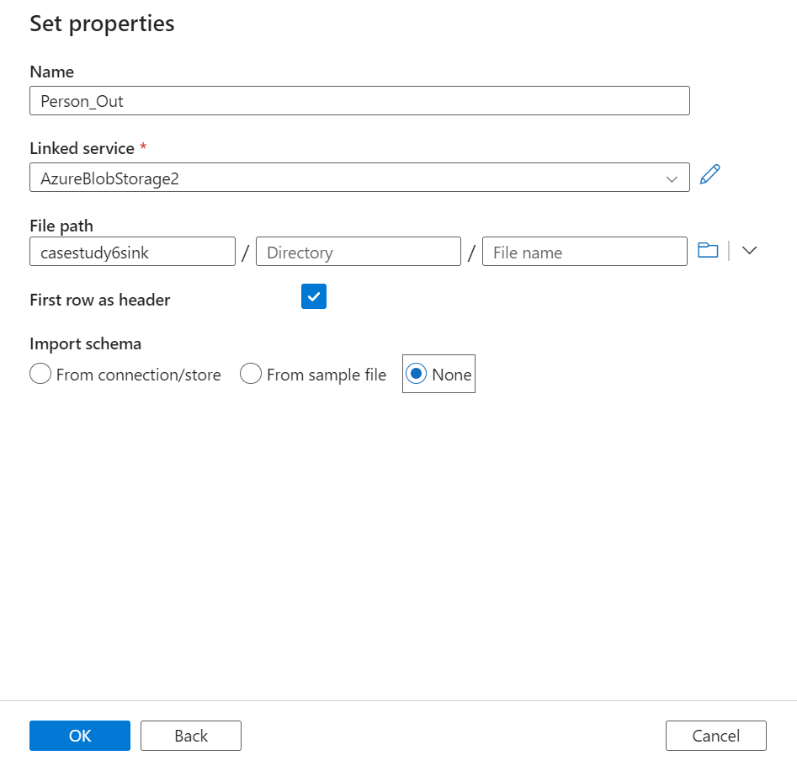

Slide 10
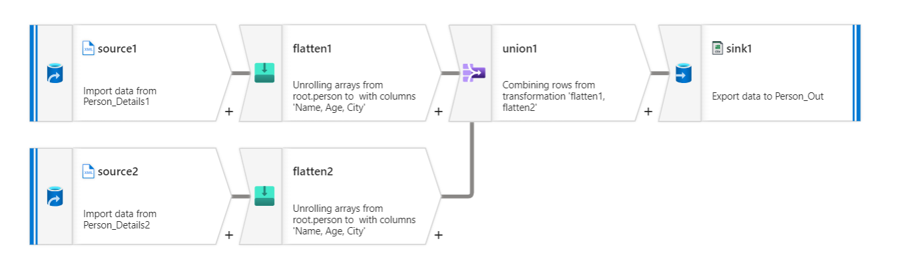

Slide 11
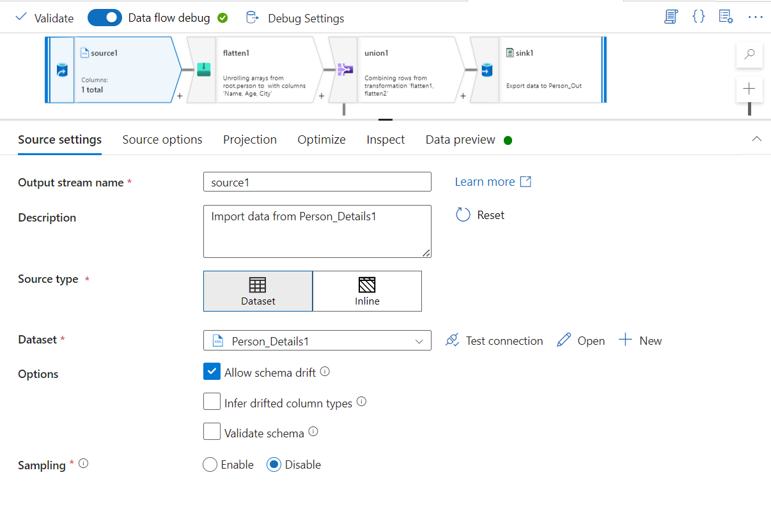

Slide 12
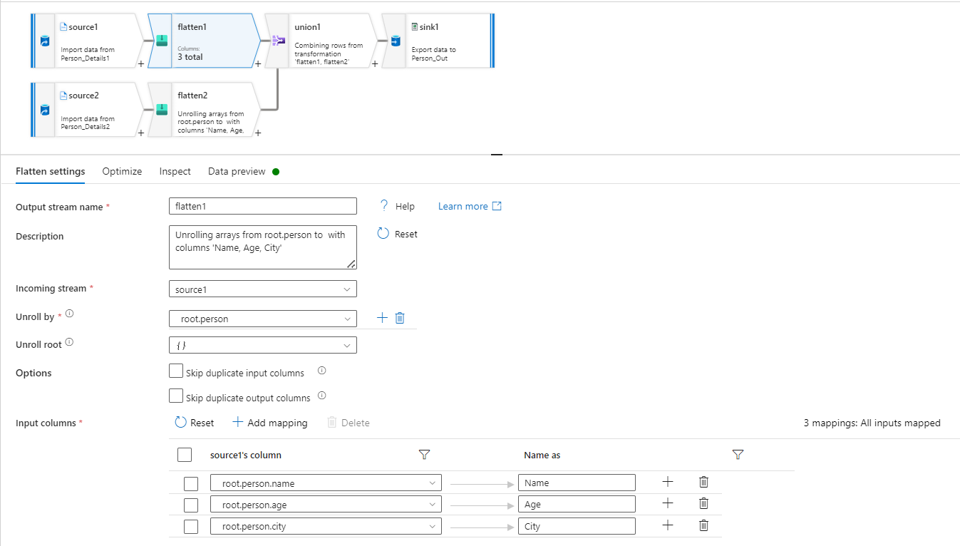

Slide 13
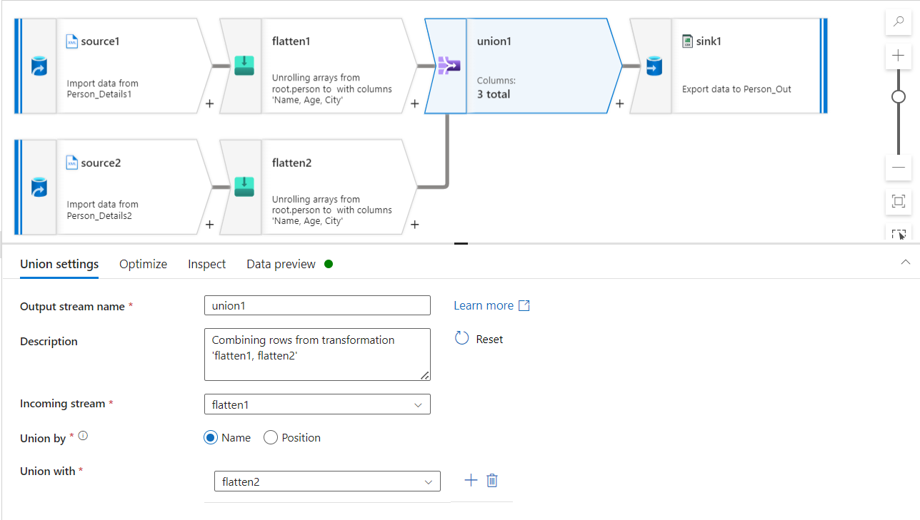

Slide 14
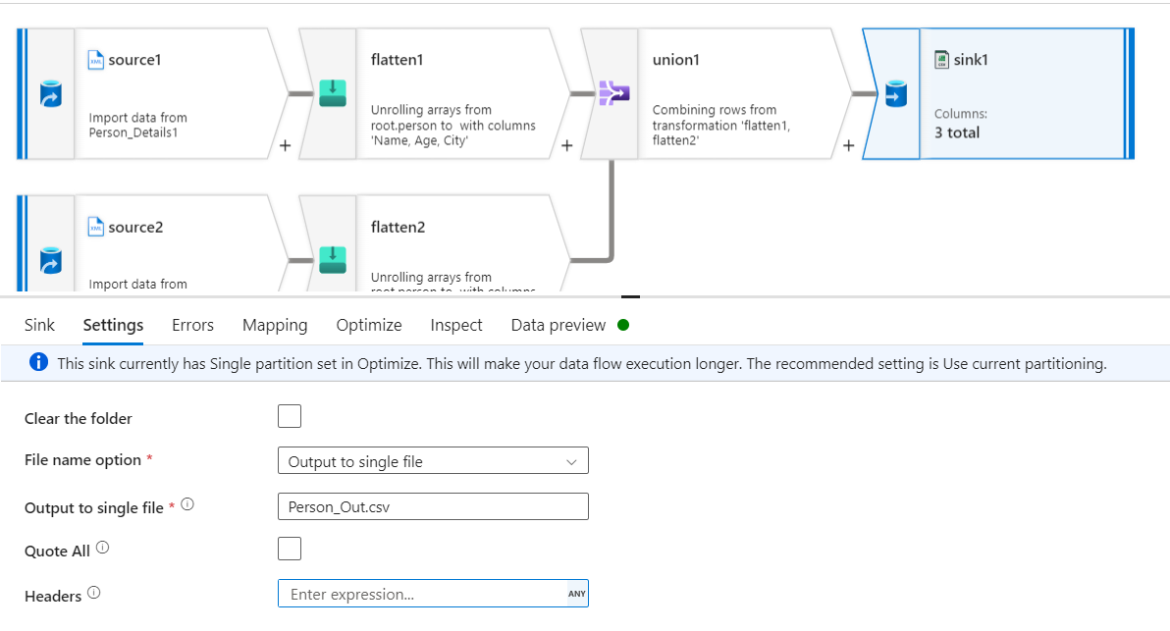

Slide 15
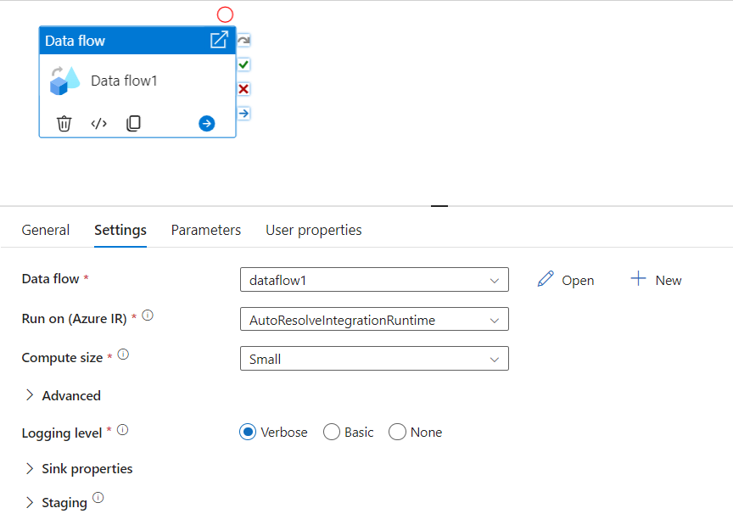

Slide 16
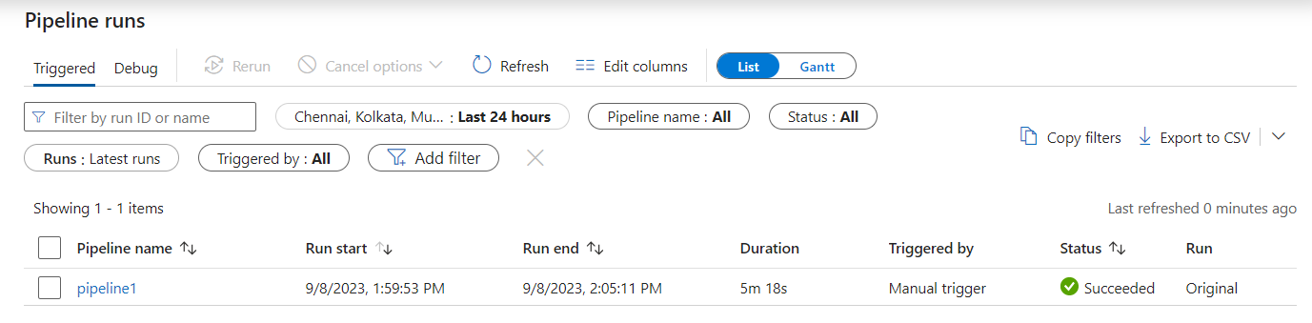

Slide 17
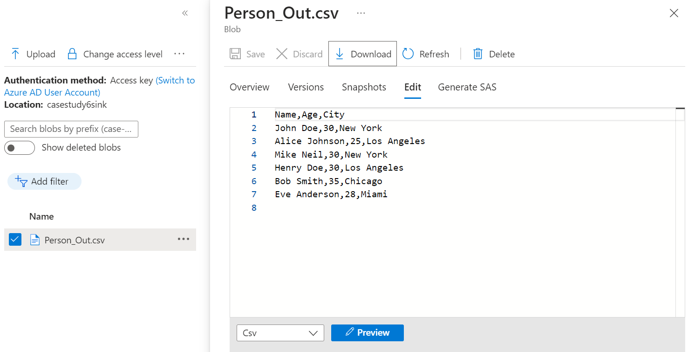
OUTPUT

